Slide 1

Saving Money Through Building Energy Efficiency:
The Opportunities
Xiaohui “Joe” Zhou, PhD, PE
Iowa Energy Center
2013 BOMA Iowa
Des Moines, IA
April 16, 2013

Slide 2
Outline
Introduction to Iowa Energy Center
Why Building Energy Efficiency is Important
Strategies to Improve Building Energy Efficiency
Steps to follow:
Know your building’s present energy performance
Analyze opportunities through an energy audit
Explore building energy improvement options
Monitor results

Slide 3
About the Iowa Energy Center
A public, non-profit organization
Was created by the Iowa General Assembly and signed into law in 1990
Has a mission to serve Iowans through reliable, objective tools, and information
Is administered through Iowa State University
Has a 13-member Advisory Council representing key constituencies and stakeholders (as described in the 1990 Energy Efficiency Act)

Slide 4
Our Mission
Advance Iowa’s energy efficiency and renewable energy use through transformative research, education, and demonstration
Strive to increase energy efficiency in all areas of Iowa’s energy use
Serve as a model for state efforts on energy efficiency and renewable energy
Conduct and sponsor research on energy efficiency and conservation, as well as alternative energy based on renewable resources
Assist Iowans in assessing energy-related technologies
Support educational and demonstration programs

Slide 5
Key Program Areas
Energy Efficiency
Building
Industrial
Agricultural
Transportation
Renewable Energy
Biorenewable
Solar
Wind
Grants and Funding
IEC Sponsored Grants
Alternate Energy Revolving Loan Program
Scholarships
Outreach
Learning Institute for training and education
Communications and Marketing

Slide 6
Why Building Energy Efficiency is Important
The Big Picture
Transportation
28%
*Based on the 2010 Energy Data Book by the Department of Energy; 1 Quads = 1 000 000 000 000 000.

Slide 7
Why Building Energy Efficiency is Important
Commercial Building Energy End-Use Type Splits
*Based on the 2010 Energy Data Book by the Department of Energy

Slide 8
Strategies to Improve Building Energy Efficiency
How much energy can be saved by doing what?
7%~28% by implementing no cost or low-cost energy efficient measures through changes in building operations and management (O&M)
3.5%~15.2% by changing occupant behavior
9.4%~25% by retrofitting lighting
7.3%~22.9% by calibrating HVAC control devices, improve control sequences, and monitoring energy use
3.5%~15.9% through replacing old HVAC equipment with new energy efficient units
*Based on BOMA International BEEP 2006 report

Slide 9
Strategies to Improve Building Energy Efficiency
Opportunities for Existing Buildings
Reduce Energy Demand: plug loads, peak demand
Improve Building Energy Efficiency: operations & management; energy audit and retro-commissioning
Use Renewable Energy Source: wind, solar
Financial Incentives: tax credits, utility rebates
*Existing buildings account for approximately 70% ~ 85% of buildings that will exist in 2030.

Slide 10
Steps to Take
Know Your Building's Energy Performance
Analyze Opportunities through an Energy Audit
Explore Building Energy Improvement Options
Monitor Results

Slide 11
Steps to Take: Know Your Building's Energy Performance
Know Your Building's Energy Performance
Calculate Energy Utilization Index (EUI)
Unit energy use for buildings in BTU/sq. ft. - year
Calculate Energy Cost Index (ECI)
Unit cost of energy for buildings in $/sq. ft. - year
*BTU = British Thermal Unit; 1 BTU ~= 0.293 Watt-Hour

Slide 12
Steps to Take: Know Your Building's Energy Performance
Gross Office Building Area: |  |  | 12500 | sq. ft.
MONTH | Electricity |  | Natural Gas |  | Total
 | Cost | Office Bldg | Energy | Cost | Energy | Cost
 | $ | Total KWH | Therms | $ | kBTU | $
January | 608.8979 | 12835.4 | 427 | 397.11 | 86507.2202 | 1006.007898
February | 533.8115 | 9923.2 | 91 | 90.47 | 42967.8816 | 624.281456
March | 389.1015 | 6779 | 101 | 91.43 | 33236.727 | 480.5315275
April | 299.5248 | 4955.8 | 50 | 45.5 | 21914.1454 | 345.0247663
May | 509.1813 | 5520 | 10 | 17.92 | 19839.76 | 527.1013084
June | 529.8775 | 5728.7 | 5 | 14.12 | 20052.0531 | 543.9974705
July | 575.858 | 6367.8 | 5 | 14.49 | 22233.3014 | 590.3479565
August | 496.5895 | 5614 | 5 | 14.26 | 19660.582 | 510.8494889
September | 226.5405 | 3734.8 | 4 | 13.38 | 13146.8724 | 239.9205187
October | 394.9498 | 6555.8 | 5 | 14.21 | 22874.9454 | 409.1598217
November | 516.2209 | 9379.5 | 64 | 61.3 | 38412.2335 | 577.5209352
December | 547.3023 | 10953.7 | 121 | 111.33 | 49484.9781 | 658.632338
Total |  |  |  |  | 390330.7001 | 6513.375486
Average |  |  |  |  | 31.23 | 0.52
* 1 KWH = 3.412 kBTU; 1 Therm = 100 kBTU |  |  |  |  | EUI (kBTU/s.q ft. - year) | ECI ($/sq. ft. - year)

Slide 13
Steps to Take: Know Your Building's Energy Performance
What is Building Energy Benchmarking and Benefits?
Building Energy Benchmarking
How did your building compare with similar buildings?
Compared to self, within a portfolio, or nationally?
Does your building energy performance meet energy code?
Benefits
Respond to rising energy costs
Enhance your company's image and attract satisfied tenants
Improve the marketability of your property by differentiating it from others

Slide 14
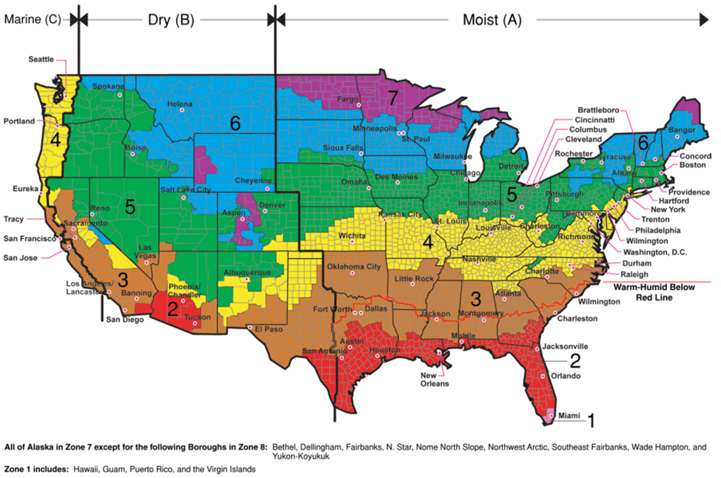
Steps to Take: Know Your Building's Energy Performance
U.S. Climate Zone Map

Slide 15
Steps to Take: Know Your Building's Energy Performance
DOE Commercial Building Benchmarks –
New Construction
EUIs (kBtu/sq. ft-yr)
October 2009
City | Chicago | Denver | Minneapolis
Climate Zone | 5A | 5B | 6A
Large Office | 43 | 36 | 46
Medium Office | 48 | 41 | 54
Small Office | 51 | 45 | 57
Warehouse | 24 | 23 | 29
Stand-alone Retail | 81 | 69 | 93
Strip Mall | 85 | 72 | 99
Primary School | 65 | 58 | 75
Secondary School | 76 | 64 | 89
Supermarket | 195 | 179 | 208
Quick Service Restaurant | 657 | 604 | 713
Full Service Restaurant | 527 | 481 | 570
Hospital | 148 | 130 | 153
Outpatient Facility | 271 | 271 | 280
Small Hotel | 80 | 74 | 87
Large Hotel | 138 | 131 | 150
Mid-Rise Apartment | 47 | 41 | 54

Slide 16
Steps to Take: Know Your Building's Energy Performance
Benchmarking Systems 1: EPA’s Energy Star Portfolio Manager
Based on national survey 2003 CBECS database by EIA (Energy Information Administration)
Provides a comparison for 15 commercial building types
Scaled in 1 – 100 relative to similar buildings nationwide (highest number is the most energy efficient building)
Building rating above 75 may receive Energy Star label
http://www.energystar.gov/index.cfm?c=evaluate_performance.bus_PortfolioManager

Slide 17
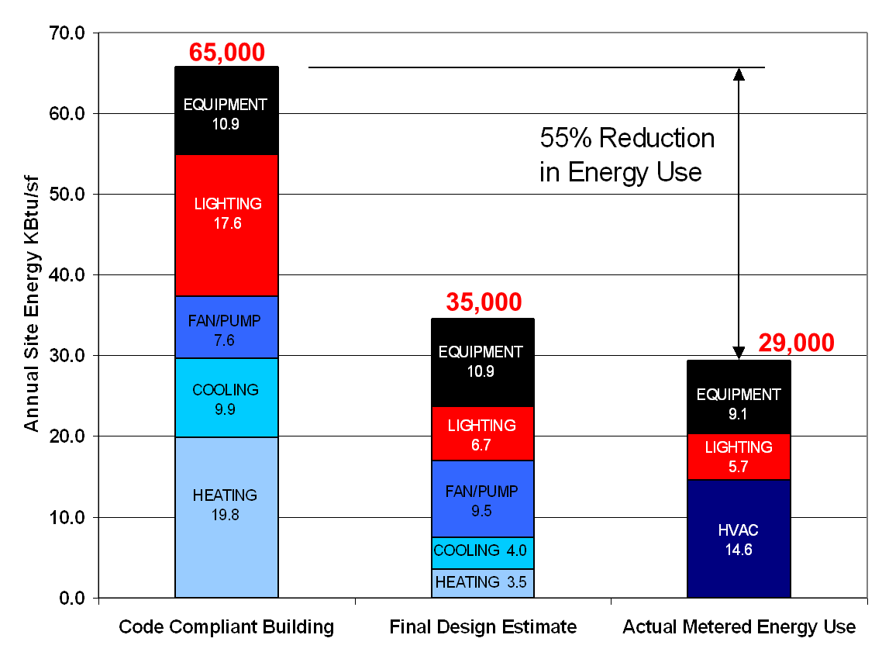
Steps to Take: Know Your Building's Energy Performance
Energy Star Rating

Slide 18
Steps to Take: Know Your Building's Energy Performance
Benchmarking Systems 2: ASHRAE Building Energy Quotient
Ratings for both design and operation
Requires more detailed information than the monthly utility bill
Provides more detailed opportunity analysis
http://buildingenergyquotient.org/

Slide 19
Steps to Take: Know Your Building's Energy Performance
Benchmarking Systems 3: U.S. Department of Energy Commercial Building Asset Score
Still being developed
Scale 1 - 100 (higher number is better)
Intended to help identify inefficient areas in building energy
http://www1.eere.energy.gov/buildings/commercial/assetscore.html

Slide 20
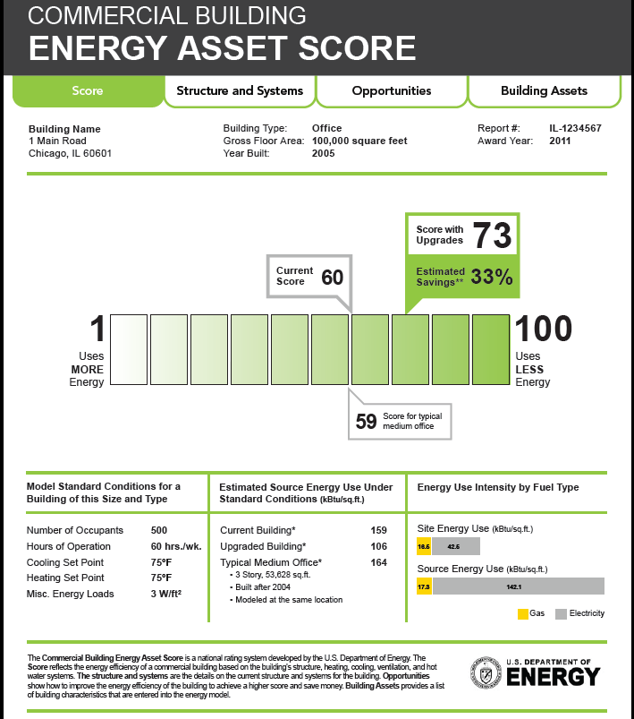
Steps to Take: Know Your Building's Energy Performance

Slide 21
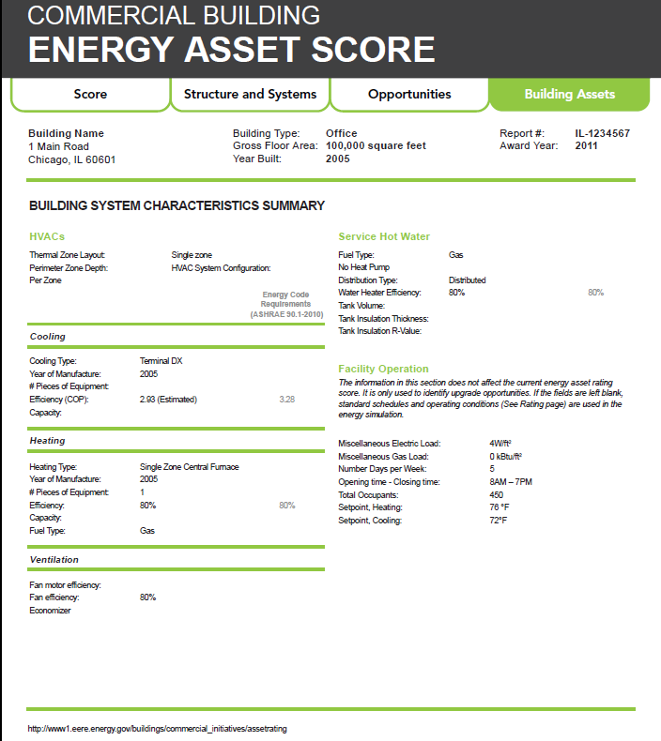
Steps to Take: Know Your Building's Energy Performance

Slide 22
Steps to Take: Know Your Building's Energy Performance
Benchmarking Systems 4: Iowa Public Building Benchmarking System
Web-based platform
Iowa public buildings (now 1200+ buildings)
Benchmarking ratio: Benchmark energy use based on current energy code. 1.0 = energy code compliant building (lower number is better)
Also includes Energy Star rating (if applicable) and peer rating
Currently recruiting up to 800 new buildings
http://www.iowaenergycenter.org/

Slide 23
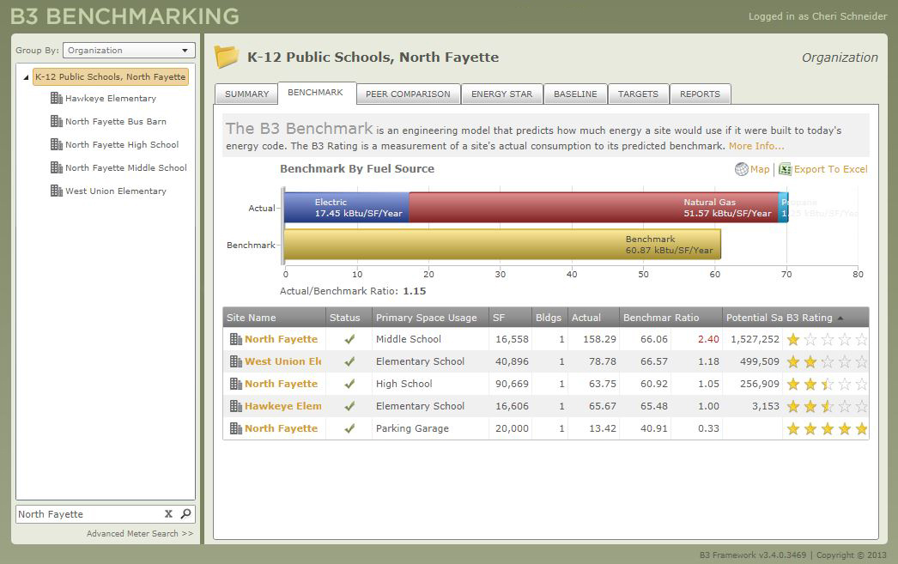
Steps to Take: Know Your Building's Energy Performance

Slide 24
Steps to Take: Analyze Opportunities
Setting Goals
10%, 20%, or 30% compared with historical EUI?
LEED for existing buildings? (O&M certification requires a minimum of 69 on ENERGY STAR rating)
Benchmarking ratio below 1.0?
Strong Management Support

Slide 25

Steps to Take: Analyze Opportunities
Analyze How and Where Did Energy Go - Prioritize
Sub-Metering
Energy Audits
Level 1: Walk-through
Level 2: Energy survey and analysis
Level 3: Detailed analysis and capital
-intensive modifications
Utility programs – no cost or low-cost for qualified customers

Slide 26
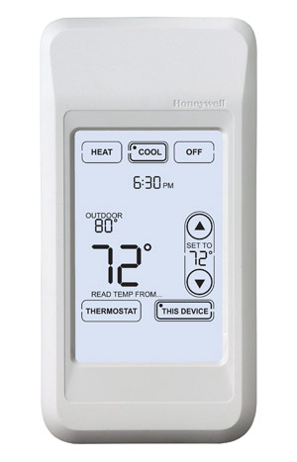
Steps to Take: Building Energy Improvement Options
Improve Building Operations – No Cost or Low-Cost
Reduce HVAC equipment's occupancy hours
Reduce lighting hours, use day lighting, or use occupancy sensors
Replace/repair/calibrate sensors
Use a programmable thermostat
Relocate/shield temperature sensors
Use economizer
Use duct static pressure reset
Use supply air temperature reset

Slide 27
Steps to Take: Building Energy Improvement Options
Use demand-controlled ventilation (DCV)
Chilled water supply temperature reset
Optimize heating water supply
Optimal start/stop
Tune HVAC control – check the thermostat schedule!
Check minimum damper position
Automated fault detection and diagnostics
Best janitorial practices

Slide 28
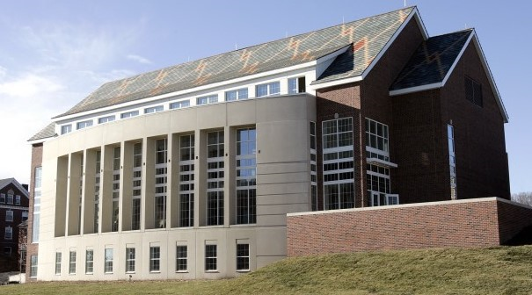
Steps to Take: Building Energy Improvement Options
Example:
Iowa State University Hixson-Lied Student Success Center
Using improved duct static pressure reset strategy, saved ~37% of fan energy
in 3 month’s field testing in this 40,528 sq. ft building; ~$3839 / year .

Slide 29
Steps to Take: Building Energy Improvement Options
Management Improvements – Low-Cost or No Cost
Make energy management a priority
Require systems manuals (operation and maintenance, etc.)
Invest in training and education for operators and occupants – change occupant behavior
Establish purchasing criteria: Energy Star-labeled appliance/equipment, CFL, LED, etc.
Insist on performance tracking and reporting

Slide 30
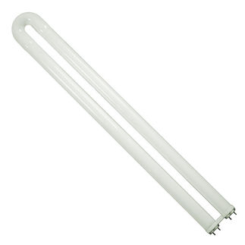
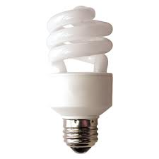
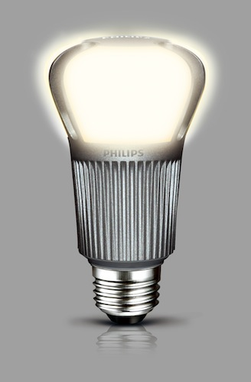
Steps to Take: Building Energy Improvement Options
Lighting Retrofit
Use occupancy sensors
Use day lighting, photo cells, and dimming controls
Replace with new energy efficient lighting
Compact Fluorescent (CFL)
Light-emitting Diode (LED)
Fluorescent T8 or T5
Use external/internal shading devices
While a modern office can be lit using <1W/sq. ft., most still use about 1.5~2W/sq. ft.

Slide 31
Steps to Take: Building Energy Improvement Options
Example: Cedar Rapids Hy-Vee Parking Lot LED Lighting Study
Replacing 1000w Metal Halide with 309w LED
*Report is available at www.iowaenergycenter.org

Slide 32
Steps to Take: Building Energy Improvement Options
Metal Halide
Metal Halide
LED
LED
*Report is available at www.iowaenergycenter.org

Slide 33
Steps to Take: Building Energy Improvement Options
Cedar Rapids Hy-Vee Parking Lot LED Lighting Study
69% Reduction
*Report is available at www.iowaenergycenter.org

Slide 34
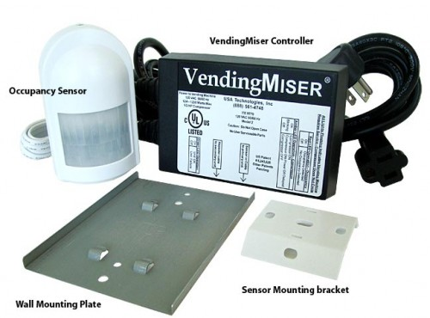
Steps to Take: Building Energy Improvement Options
Plug Loads Control
Check your building's phantom loads
Apply power management software: put equipment in sleep mode
Use energy misers: vending miser, cooler miser, snack miser, plug miser, etc.

Slide 35
Steps to Take: Building Energy Improvement Options
Fix Building Envelope Problems
Increase insulation making sure it is installed correctly (roof, wall, etc.)
Find and fix air leaks
Upgrade windows
At a minimum, use double-pane windows
High efficiency low-e window
Electro-chromic and thermo-chromic windows
Window-to-Wall ratio should be < 35%

Slide 36
Steps to Take: Building Energy Improvement Options
Upgrade HVAC System and/or Replace Old HVAC Equipment
Any RTUs, electric boilers, or control systems that are older than 10~15 years
Chillers, pumps, fans, boilers, motors older than 15~20 years
Pneumatic control system of any age
Consider adding Energy Recovery Unit (ERU)

Slide 37
Steps to Take: Building Energy Improvement Options
Upgrade to high efficiency fans and motors controlled with variable frequency drives (VFD)
Convert constant-air-volume (CAV) system to variable-air-volume (VAV) system
Change central domestic hot water systems to point-of-use water heaters; install high efficiency water heaters
Many other options depending on the project

Slide 38
Steps to Take: Building Energy Improvement Options
Making the business case
Simple payback = project cost / annual change in cash flow
Net present value (NPV) – accounts for the time value of money
Internal rate of return (IRR)
Life-cycle cost analysis (LCC)
Average retro-commissioning cost $0.27/sq. ft.; ~15% energy savings; simple payback ~0.7 years*
Research available incentives
Database of State Incentives for Renewables & Efficiency: http://www.dsireusa.org
*Based on Mills, et al. 2004 study (DOE Lawrence Berkeley National Laboratory)

Slide 39
Steps to Take: Monitor Results
Continuously Monitor Results
Develop an effective operation and management plan
Be persistent!
Iowa Public Building Benchmarking System

Slide 40
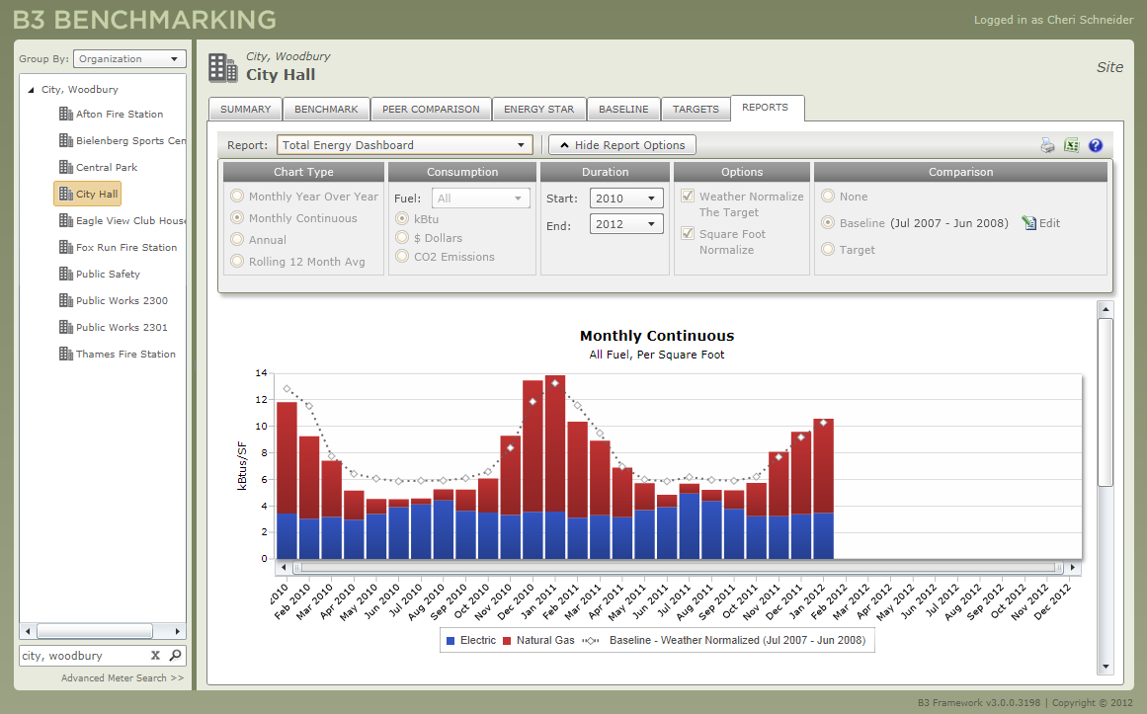
Steps to Take: Monitor Results

Slide 41
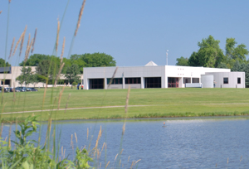
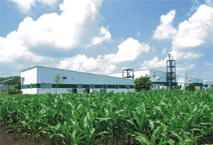


Questions?
Xiaohui “Joe” Zhou, PhD, PE
xhzhou@iastate.edu
Iowaenergycenter.org

